Slide 1
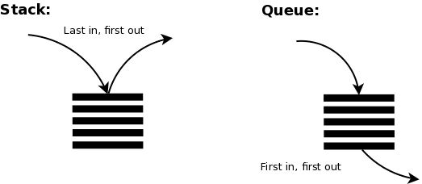
Stack and Queues in Python
Unlike C++ STL and Java Collections, Python does have specific classes/interfaces for Stack and Queue.
Stack works on the principle of “Last-in, first-out”. Also, the built-in functions in Python make the code short and simple. To add an item to the top of the list, i.e., to push an item, you can use append() function as well and to pop out an element we will use pop() function.

Slide 2
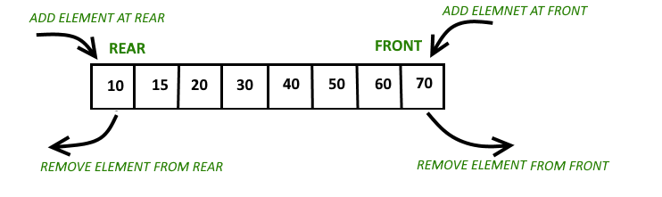
Stack and Queues in Python
Queue works on the principle of “First-in, first-out”.
A deque stands for Double-Ended Queue. It is a data structure that allows adding and removing elements from both ends efficiently. Unlike regular queues, which are typically operated on using FIFO (First In, First Out) principles, a deque supports both FIFO and LIFO (Last In, First Out) operations.

